Slide 1
ATM SERVICE WINDOWS APPLICATION
SIFAT JAHAN
ALIGARH MUSLIM UNIVERSITY

Slide 2
FUNCTIONALITIES
WELCOME WINDOW: welcome the user and give option to login to the old user and sign up to the registered user.
SIGN UP WINDOW: user enter their user name and password
LOGIN WINDOW: user can login by entering username and password.
MAIN WINDOW: gives different option like deposit money, check balance, withdraw, change password, Return card

Slide 3
FOR RUNNING THE FILE
Install MySQL database
Install tkinter and pymysql package using
->pip install tkinter
->pip install pymysql
Create database ATM
In ATM database create table for name, password, balance as rows in the table

Slide 4
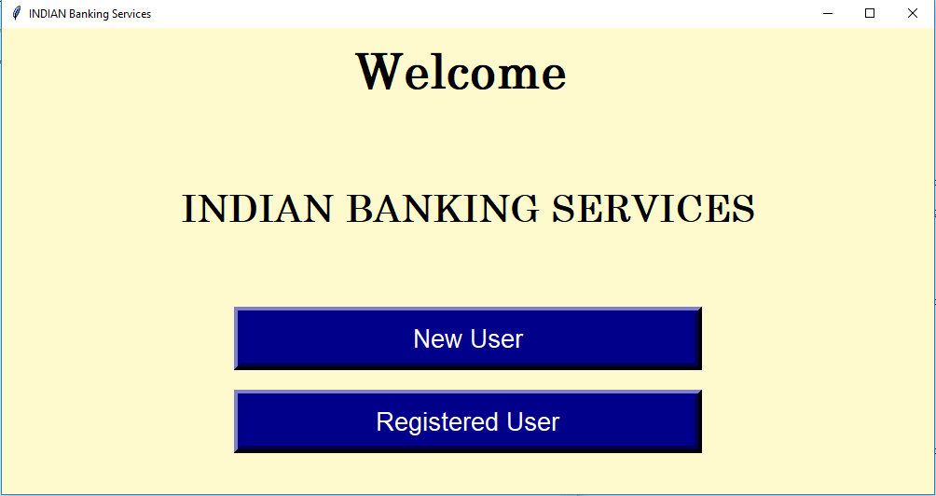
WELCOME PAGE OF ATM SERVICE

Slide 5
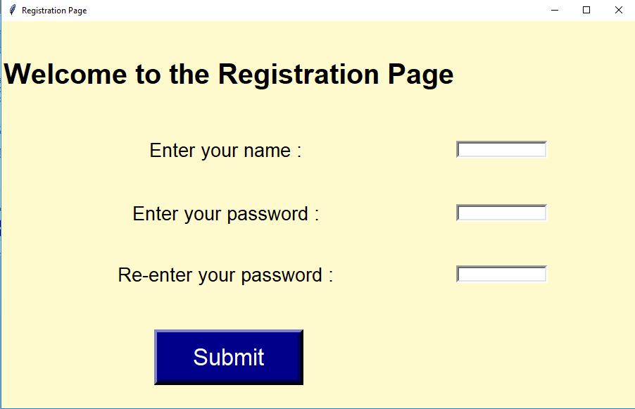
REGISTRATION FOR NEW USERS

Slide 6
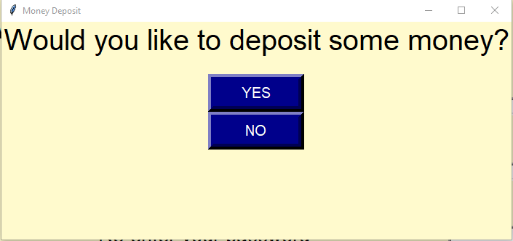
NEXT WINDOW AFTER REGISTRATION

Slide 7
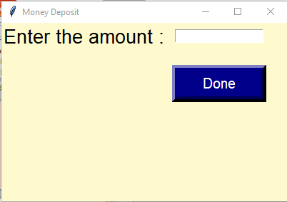
IF THE SELECTED OPTION IS YES

Slide 8
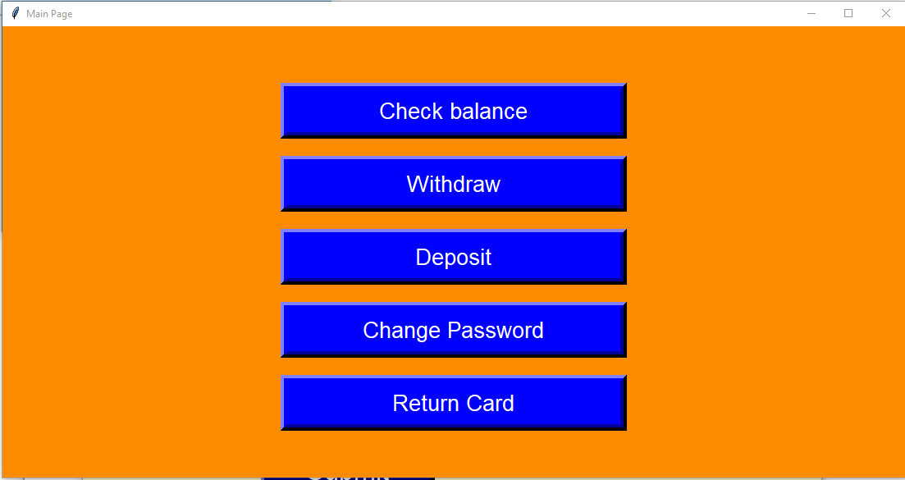
AFTER DEPOSITION OF MONEY

Slide 9
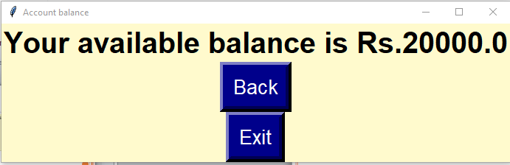
CLICKING ON CHECK BALANCE OPTION

Slide 10
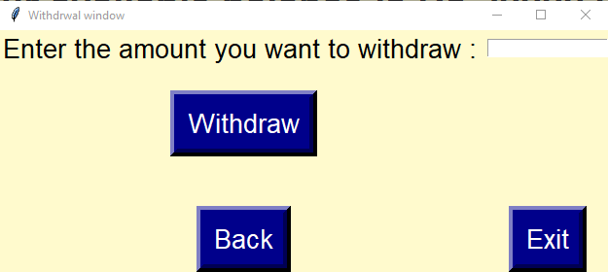
WITHDRAWL WINDOW

Slide 11
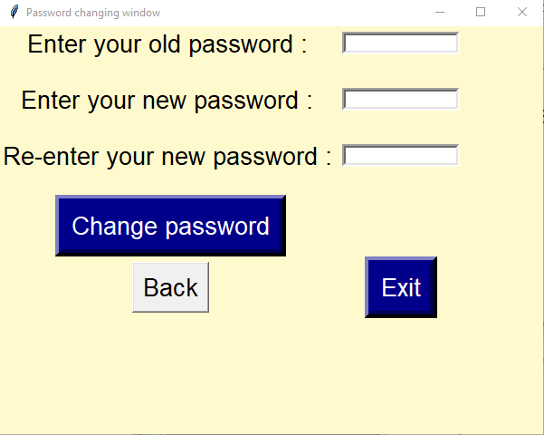
CHANGING PASSWORD

Slide 12
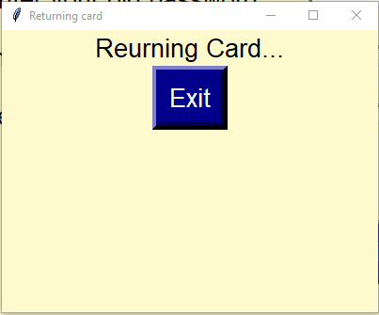
RETURN CARD

Slide 13
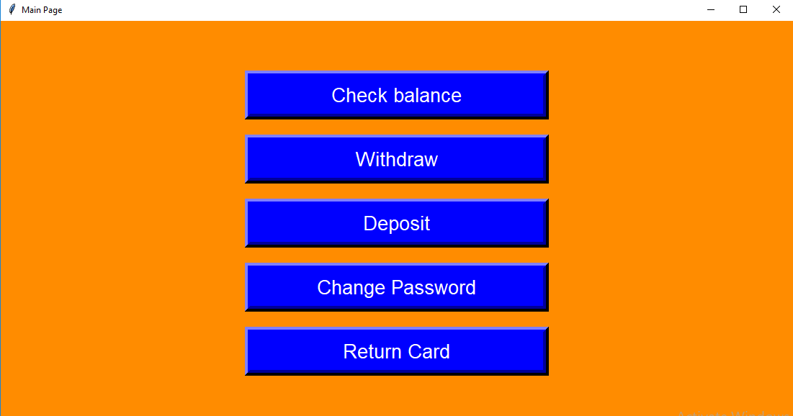
IF THE OPTION SELECTED IS NO

Slide 14
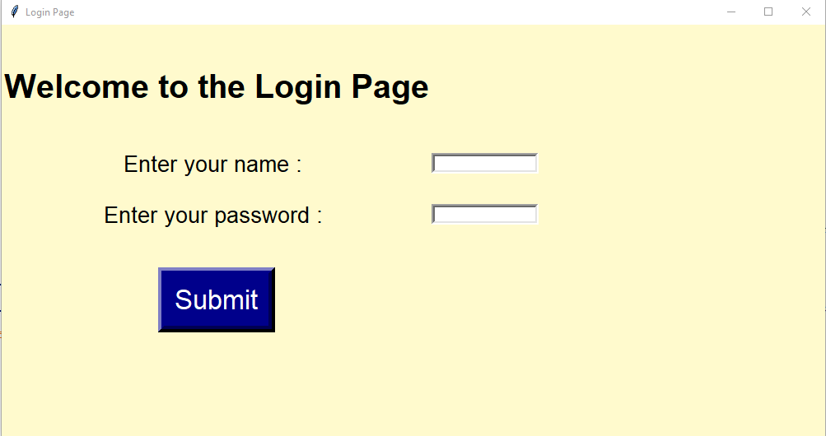
LOGIN PAGE

Slide 15
NEXT WINDOW

